Slide 1
Working with Data Blocks and Frames
Notes:
Schedule: Timing Topic
45 minutes Lecture
40 minutes Guided Practice
85 minutes Total

Slide 2
Objectives
After completing this lesson, you should be able to do the following:
  Identify the components of the Property Palette
  Manipulate properties through the Property Palette
  Control the behavior and appearance of data blocks
  Control frame properties
  Create blocks that do not directly correspond to database tables
  Delete data blocks and their components
Notes:
Introduction
Overview
In this lesson you will learn how to customize existing data blocks and modify frames. You will also learn how to include blocks that are not associated with the database.

Slide 3
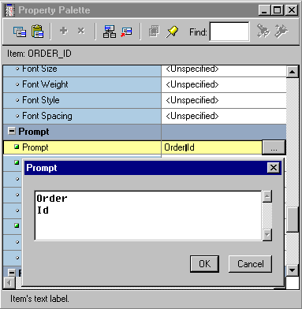
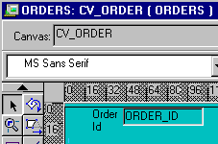
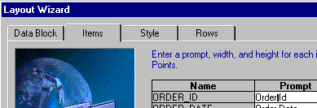
Managing Object Properties
3
  Reentrant Wizard
    Data Block Wizard
    Layout Wizard
  Layout Editor
  Property Palette
1
2
Notes:
Managing Object Properties
There are three ways to modify properties of Forms Builder objects:
Reentrant Wizards: You can modify data block and layout properties through the reentrant wizards, as explained in the previous lesson.
Layout Editor: If the object appears on a canvas, you can modify properties by using the graphical Layout Editor.
Property Palette: You can set individual properties for each Forms Builder object in its Property Palette.
The wizards, the Layout Editor, and the Property Palette all depict object properties. Changes made in one tools are reflected in the others. In the example above, the prompt for ORDER_ID is shown identically in:
1. Reentrant Layout Wizard
2. Layout Editor
3. Property Palette
You can use the Property Palette to control the behavior and appearance of any Forms Builder object with a greater degree of granularity. In the Property Palette you can fine-tune objects that you have initially created in the wizards or the Layout Editor.

Slide 4
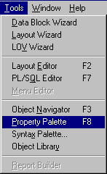
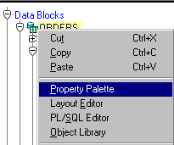
Displaying the Property Palette
To display the Property Palette, use one of the following methods:
  Select Tools > Property Palette (or use the shortcut key).
  Double-click the object icon in the Object Navigator.
  Double-click the object in the Layout Editor.
  Right-click the object icon in
  the Object Navigator.
  Right-click the object in the Layout Editor.
Notes:
Property Palette
Every object in a form module, as well as the form module itself, has properties that dictate the object’s behavior. When an object is first created, it is automatically assigned several property values by default. You can change these property values in the Property Palette.
Displaying the Property Palette
To display the Property Palette of an object, use one of the following methods:
Select the object in the Object Navigator and then select Tools > Property Palette from the menu.
Double-click the object icon for the object in the Object Navigator (except for code objects and canvases).
Double-click an item in the Layout Editor.
Right-click the object in the Layout Editor or the object icon in Object Navigator. From the pop-up menu, select the Property Palette option.

Slide 5
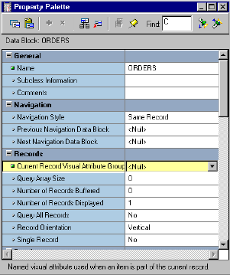
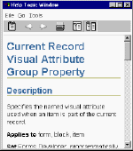
Property Palette: Features
Find field
Toolbar
Expand/
Search
Collapse
Backward
Search
Forward
Property
Property
name
value
Help:
Press [F1]
Notes:
Property Palette: Features
Features of the Property Palette include the following:

Slide 6
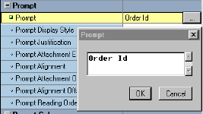
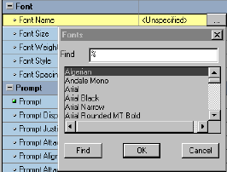

Property Controls
Text field
More button
LOV window
Pop-up list
Notes:
Using the Property Palette
Each form object has various types of properties. Properties are manipulated differently, depending on the property type. The following is a summary of the controls that are used in the Property Palette:

Slide 7
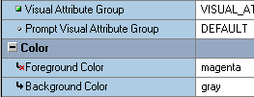
Property Controls
Changed
Default
Overridden
Inherited
Notes:
Property Palette Icons
Each property in a Property Palette has an icon to its left. The following is a summary of these icons and their description:
Note: Once you activate the Property Palette, its window remains open until you close it. The window automatically displays the properties of each object you visit in the Layout Editor or Object Navigator. This is because, by default, the list of properties in the Property Palette is synchronized whenever you select an object.
You can turn the synchronization on or off for a specific palette by clicking Pin/Unpin in the Property Palette toolbar.

Slide 8
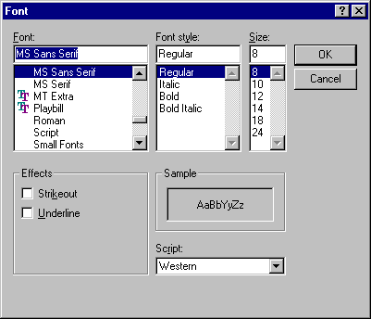

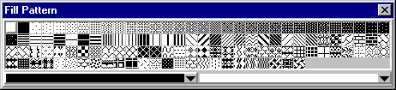
Visual Attributes
A Visual Attribute is a named set of properties defining:
  Font
  Color
  Pattern
Notes:
Visual Attributes
Visual attributes are the font, color, and pattern properties that you set for form and menu objects.
A Visual Attribute is another object that you can create in the Object Navigator with properties such as font, color, and pattern combinations. Set the Visual Attribute Type property of the Visual Attribute to Title if you plan to apply it to objects such as frame titles, or to Prompt if it will be used for prompts. Otherwise, set Visual Attribute Type to Common, which is the default.
Every interface object in a forms application has a property called Visual Attribute Group, which determines how the individual visual attribute settings of an object are derived. The Visual Attribute Group property can be set to Default, NULL, or the name of a Visual Attribute object. Blocks have a Current Record Visual Attribute Group property that defines the Visual Attribute to be used for the current record in the block.
Partial Visual Attributes
You can define a Visual Attribute by setting only the properties that you want to be inherited by the objects that use them. This means that you can apply a Visual Attribute that changes the font color without having to set the font name.

Slide 9
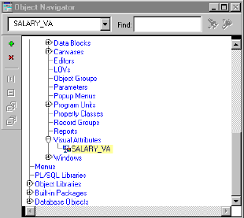
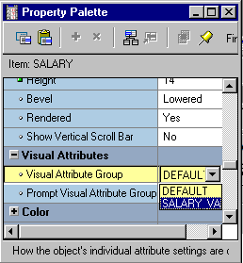
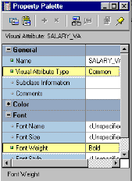

How to Use Visual Attributes
  1. Create a Visual Attribute.
  2. Set the Visual Attribute related property of an object to the desired Visual Attribute.
  3. Run the form to see the effect.
1
2
3
Notes:
Using Visual Attributes
To use a Visual Attribute, perform the following steps:
1. Create the Visual Attribute:
Select the Visual Attributes node in the Object Navigator
Click Create
Invoke the Property Palette for the Visual Attribute and set the desired font, color, and pattern properties
2. Set the object properties to use the new Visual Attribute:
For items and canvases, set the Visual Attribute Group property
For blocks, set the Current Record Visual Attribute Group property
Run the form to see the changes.
Instructor Note
Demonstration: Create a Visual Attribute to be used later in this lesson. Use the Color, Pattern, and Font pickers. Use the ordwk04.fmb file.

Slide 10
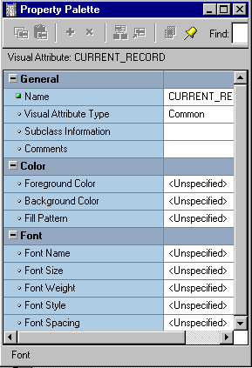


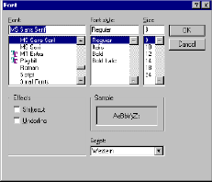
Font, Pattern, and Color Pickers
Notes:
Font, Pattern, and Color Picker
When you create Visual Attributes, you can use the Font, Pattern, and Color Pickers to select the font, pattern, and color.
When changing a font from the Property Palette, you can click the Font group itself to invoke the Font Picker. This enables you to select all font properties from one window; otherwise you can select each font property and invoke individual windows or pop-up lists that are specific to the property.

Slide 11
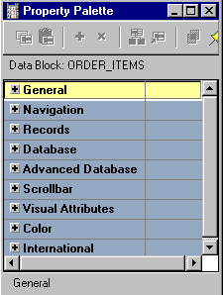
Controlling Data Block Behavior and Appearance
Data Block Property Groups:
  General
  Navigation
  Records
  Database
  Advanced Database
  Scrollbar
  Visual Attributes
  Color
  International
Notes:
Data Block Properties
Each data block has several properties. These properties are divided into groups as shown in the slide.
You can modify the properties of the data block to control both the appearance and the behavior of the block.

Slide 12

Navigation Properties
ORDERS
Order
Previous Navigation Data Block
Item
Same
Record
Next
Record
Next Navigation Data Block
Notes:
Controlling the Behavior of Data Blocks: Setting Navigation Properties
Navigation Style: Normally, when you navigate beyond the last item in a record, Forms returns you to the beginning of the same record. With this property you can change this behavior to navigate to the next record or data block instead. The valid settings are: Same Record (default), Change Record, or Change Data Block.
Note: If you want the cursor to move to the next record when you reach the end of the current record, set the Navigation Style property for the block to Change Record.
Previous/Next Navigation Data Block
Normally, when you perform an operation to move to the previous or next data block at run time, Forms moves control to the previous or next adjacent data block in sequence. These properties enable you to name the previous or next data block.
Instructor Note
Demonstration
Use the ordwk04.fmb file to show the run-time effect of changing the Navigation Style property on the ITEMS block.

Slide 13
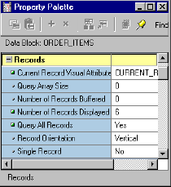
Records Properties
Item
Current Record
Number
of Records
Displayed
Notes:
Controlling the Behavior of Data Blocks: Setting Record Properties
Current Record Visual Attribute Group: The Visual Attribute that will be used to highlight the current record in the data block.
Query Array Size: Specifies the maximum number of records that Forms should fetch from the database at one time. A lower value in this property value means faster response time; however, a larger value means fewer calls to the database for records, thereby resulting in reduced overall processing time. This property defaults to the Number of Records Displayed.
Number of Records Buffered: Is the minimum amount of buffer space retained for holding queried records in the data block. The minimum setting allowed is the value of the Number of Records Displayed property plus 3. Forms buffers any additional records to a temporary disk file. A higher value improves processing speed, but uses more memory.
Instructor Note
Demonstration: Using the ordwk04.fmb, assign the Visual Attribute created earlier to the ITEMS block property Current Record Visual Attribute Group. Show the run time effect of doing this. Also show how to increase or decrease the number of records displayed in a data block.

Slide 14
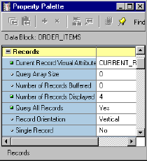
Records Properties
Vertical Record Orientation
Horizontal Record Orientation
Notes:
Controlling the Behavior of Data Blocks: Setting Record Properties (continued)
Number of Records Displayed: This property specifies the maximum number of records the data block can display on the canvas at one time and how many records you can see at once. If you change this value, make sure there is enough room on the canvas layout for the number of records, or objects may overlap.
Query All Records: This property specifies whether all the records matching the query criteria should be fetched when a query is executed. (This query is necessary to support the Calculated Field feature.)
Record Orientation: This property determines the orientation of records in the data block—horizontal or vertical. When you set this property, Forms Builder adjusts the display position of items in the data block accordingly.
Single Record: This property specifies that the control block should always contain one record. Set this property to Yes for a control block that contains a summary calculated item.
Note: You cannot set this property to Yes for a data block item.

Slide 15
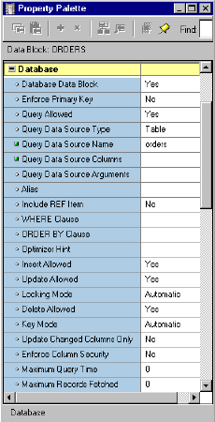
Database Properties
Use properties in the Database group to control:
  Type of block—data or control block
  Query, insert, update, and delete operations on the data block
  Data block’s data source
  Query search criteria and default sort order
  Maximum query time
  Maximum number of records fetched
Notes:
Controlling the Behavior of Data Blocks: Setting Database Properties
In the Database group of the Property Palette, you can set numerous properties to control interaction with the database server. Some of these properties are:
Database Data Block: Set to Yes if the data block is based on a database object and No if it is a control block.
Enforce Primary Key: Controls whether Forms checks for uniqueness before inserting or updating records in the base table, in order to avoid committing duplicate rows in the database. A value of Yes means that the form checks that inserted or updated records are unique before an attempt is made to commit possible duplicate rows.
Query/Insert/Update/Delete Allowed: Control whether the associated operations can be performed on the data block records.
Instructor Note
Due to time constraints, discuss only the properties depicted on the slides. Remind students that they can select any property and press [F1] to get context-sensitive help about it.

Slide 16
Notes:
Controlling the Behavior of Data Blocks: Setting Database Properties (continued)
Query Data Source Type: Specifies the type of the query data source for the data block. Possible values for this property are None, Table, Procedure, Transactional Triggers, or FROM clause query.
Query Data Source Name: Specifies the name of the query data source for the data block. This property is used only if the type of the query data source is Table, FROM clause query, or Procedure.
Query Data Source Columns: Specifies, in a dialog box, the name and data type of the columns associated with the query data source. This property is used only if the type of the query data source is Table, FROM clause query, or Procedure.
Query Data Source Arguments: Specifies, in a dialog box, the names, datatypes, and values of the arguments that are to be passed to the procedure for querying data. This property is valid only when the Query Data Source Type property is set to Procedure.
WHERE Clause: Specifies a SQL condition that is attached to every default SELECT statement associated with the data block through implicit SQL; use to define general restrictions on the rows this data block may fetch. This clause is automatically appended (ANDed) with any conditions supplied by the operator in Enter Query mode.
ORDER BY Clause: Defines a default order for records displayed from a query. The operator can alter this order by using the Query Where dialog box at run time.
Optimizer Hint: Specifies a hint string that Forms passes to the Optimizer when constructing implicit SQL on the data block. The Optimizer can improve the performance of database transactions.
Locking Mode/Key Mode: Controls how Forms handles records and transactions when the data block is primarily associated with non-Oracle data sources. The default settings are usually appropriate for data blocks connected with an Oracle database.
Update Changed Columns Only: When this property is set to Yes, only those items updated by the operator are written to their corresponding database columns. If the operator commonly updates or inserts records with only one or two columns, this can save network traffic. By default, this property value is set to No, so that all columns are included in the default UPDATE statement.

Slide 17
Database Properties
Records
fetched
Records buffered
Block display
SELECT ....
WHERE Clause
[ORDER BY Clause]
Work file
Notes:
Setting Database Properties (continued)
Enforce Column Security: When this property is set to Yes, items in the data block can be updated only if the current user has permission to update the corresponding database columns.
Maximum Query Time: Provides the option to abort a query when the elapsed time of the query exceeds the value of this property; useful when the Query All Records property is set to Yes.
Maximum Records Fetched: Provides the option to abort a query when the number of records fetched exceeds the value of this property; useful when the Query All Records property is set to Yes.
Instructor Note
When Update Changed Columns Only is set to No, Forms Builder can reuse the same SQL statement for multiple updates without the database having to reparse each time in its system global area (SGA). Changing this property value to Yes can degrade performance because the database must reparse the UPDATE statement each time.

Slide 18
Scroll Bar Properties
Scroll Bar X/Y
Position
Record
Scroll
Bar
Height
Scroll Bar Width
Notes:
Controlling the Behavior of Data Blocks: Setting Scroll Bar Properties
In the Scrollbar group of the Property Palette, you can set numerous properties to the appearance and function of the data block’s scroll bar. Some of these properties are:
Show Scroll Bar: Specifies whether Forms Builder should create a scroll bar for the data block. To delete an existing scroll bar, set this property to No.
Scroll Bar Canvas: Specifies the canvas on which the data block scroll bar will be displayed. The specified canvas must exist in the form.
Scroll Bar Orientation: Specifies whether the scroll bar should be displayed horizontally or vertically.
Scroll Bar X/Y Position: Specifies the x and y coordinates (measured in the coordination system units of the form) where the scroll bar will display on the canvas. The default value for both coordinates is 0.
Scroll Bar Width/Height: Specifies the width and height of the scroll bar.

Slide 19
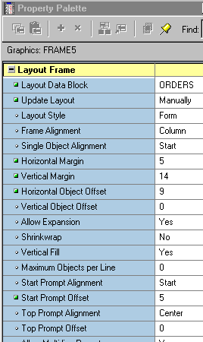
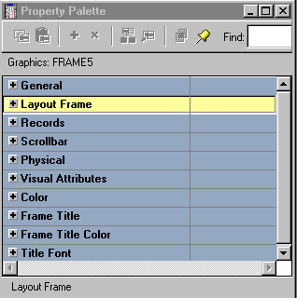
Controlling Frame Properties
Notes:
Controlling Frame Properties
The selections that you make in the Layout Wizard when creating a data block are recorded as properties of the resulting layout frame object. You can change frame properties to modify the arrangements of items within a data block. The main frame properties are as follows:
Layout Data Block: Specifies the name of the data block with which the frame is associated. The items within this data block are arranged within the frame.
Note: A data block can be associated with only one frame. You cannot arrange a block item within multiple frames.
Update Layout: Specifies when the frame layout is updated. Valid settings are:
Automatically: The layout is updated whenever you move or resize the frame, or modify any frame layout property.
Manually: The layout is updated whenever you use the Layout Wizard to modify the frame, or in the Layout Editor, when you click Update Layout or select the Layout > Update Layout menu option.
Locked: The layout is locked and cannot be updated.

Slide 20
Controlling Frame Properties
Order
Form
Layout
Style
Item
Tabular
Layout
Style
Distance
between
records
Notes:
Controlling Frame Properties (continued)
Layout Style: Specifies the layout style for the items within the frame. Choose between Form and Tabular styles.
Distance Between Records: Specifies the physical distance (measured in the form’s coordination system units) with which to separate records displayed in the frame.
X/Y Position: Specifies the x and y coordinates (measured in the form’s coordination system units) of the frame’s position on the canvas.
Width/Height: Specifies the width and height of the frame (measured in the form’s coordination system units).
Note: You can arrange a frame as well as the objects within it manually in the Layout Editor.
Instructor Note
Stress the importance of the Update Layout property.

Slide 21
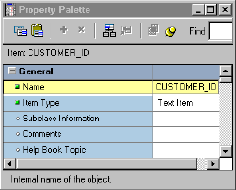
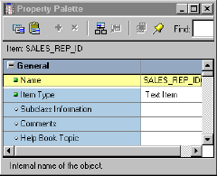
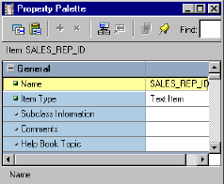
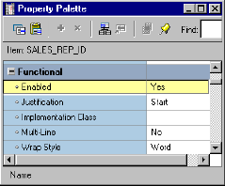
Displaying Multiple Property Palettes
  Two Palettes for Two Items:
  Two Palettes for One Item:
Notes:
Displaying Multiple Property Palettes
More than one Property Palette for one object:
You may want to see more properties for an object than there is room for in a single Property Palette. To display the properties of an object in multiple Property Palettes, perform the following steps:
1. Open a Property Palette for the object.
2. Hold down the [Shift] key and double-click the object icon for the object in the Object Navigator.
More than one Property Palette for multiple objects:
You may want to display properties for multiple objects simultaneously. To display the Property Palettes for multiple objects at the same time, perform the following steps:
1. Open the Property Palette of the first object.
2. Click Pin/Unpin on the toolbar to “freeze” this palette.
3. Invoke the Property Palette for another object. This Property Palette appears in a separate window.
If the second window is on top of the first one, drag it so that both windows are visible.

Slide 22
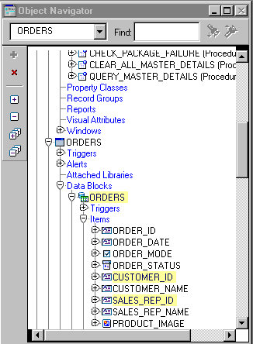
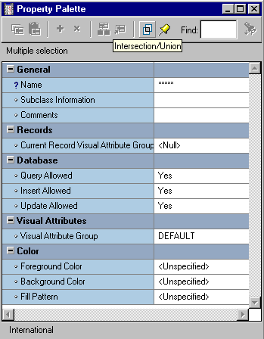
Setting Properties on Multiple Objects
Intersection/
Union
Notes:
Setting Properties on Multiple Objects
You can view and set the properties of several objects simultaneously, whether they are the same or different object types. You can select the objects in the Object Navigator and display a combination of the properties in the Property Palette. The combination may be:
Intersection: A subset in which you display only the common properties of the selected objects (This is the default set operator.)
Union: A superset in which you display both the common properties and the unique properties of the selected objects
Where there are differing values for a property across the selected objects, you will see ***** in the property value. This changes to a definitive value once you enter a new value in the Property Palette. This new value then applies to each of the selected objects to which the property is relevant.

Slide 23
Notes:
Setting Properties on Multiple Objects (continued)
How to Set Properties on Multiple Objects
To set properties on multiple objects at one time, perform the following steps:
1. Open the Property Palette for one of the objects.
2. Hold down the [Ctrl] key and click each object in the Object Navigator or the editors whose properties are to be viewed or changed in combination. The selected objects are highlighted.
3. Set the Intersection/Union button from the toolbar in the Property Palette to the desired operation. This button toggles between the two options.
4. Change the displayed properties, as required. Your changes are applied to all selected objects with these properties.
Note: With a union, you may see some properties that are not relevant to all of the selected objects. Changes to a property are applied only to objects that have the property.
Instructor Note
Show how to select multiple objects in the Object Navigator, and how their combined properties can be represented in the Property Palette. Switch between Intersection and Union, pointing out the difference between the properties.

Slide 24
Copying Properties
Copy
Paste
Name ITEMS
Query All Records No
Query Allowed Yes
Insert Allowed Yes
Update Allowed Yes
Delete Allowed Yes
Query All Records Yes
Query Allowed Yes
Insert Allowed Yes
Update Allowed No
Delete Allowed Yes
Properties
Source objects
Destination objects
Notes:
Copying Properties
You can copy the properties and values from the Property Palette to a buffer, so that they can be applied (pasted) to other objects in your design session. To copy properties, perform the following steps:
1. In the Property Palette, display and set the properties that are to be copied. This may be from one object or a combination of objects.
To copy all property settings from the Property Palette, select Edit > Select All.
To copy the selected property settings only, press and hold [Ctrl] while you click each property individually.
2. Click Copy Properties on the toolbar of the Property Palette.
3. From the Object Navigator select the object into which the properties are to be copied.
4. In the Property Palette, click Paste Properties. The selected object receives values from all copied properties that are relevant to their object types.
Note: It is possible to copy the property settings of an object to objects of different types. In this case, properties that do not apply to the target object are ignored.

Slide 25
Notes:
Property Classes
When you display a list of properties (from either one object or a combination of objects) in the Property Palette, the list of property names and associated values can be saved for future application to other objects. This is known as a property class, which is a Forms Builder object in its own right.
Objects can inherit some of their properties from a linked property class, so their properties will automatically change if the associated properties are changed in the property class.
Property classes are discussed in more detail in a later lesson.
Instructor Note
Show how to copy the properties of one object to another. Do not save the effects of this demonstration.
Note: Property inheritance and variance are covered in a later lesson.

Slide 26
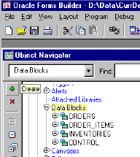
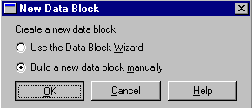
Creating a Control Block
  Click the Data Blocks node
  Click the Create icon
  OR
  Select Edit > Create.
  Select the “Build a new data
  block manually” option in the
  New Data Block dialog box.
Notes:
Creating Control Blocks
A control block is a block that is not associated with any database, and its items do not relate to any columns within any database table.
This means that Forms does not perform an automatic query when the operator issues an Enter Query or Execute Query command, nor does it issue an automatic Insert, Update, or Delete for the block when the operator saves changes to the database.
How to Create a Control Block
1. Click the Data Blocks node in the Object Navigator.
2. Click the Create icon on the toolbar, or Select Edit > Create from the menu.
3. In the New Data Block dialog box, select the “Build a new data block manually” option.
4. Open the Property Palette of the new data block and change its name.
Note: Because there are no database columns on which to base control block items, a control block has no items until you manually add them later.
Instructor Note
Demonstration: Create a control block in the form module, using the ordwk04.fmb file.

Slide 27
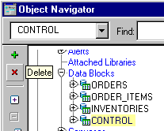
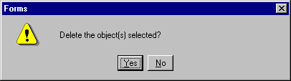
Deleting a Data Block
  Select a data block for deletion
  Click the Delete icon
  OR
  Press [Delete]
  Click Yes in the alert box.
Notes:
Deleting Data Blocks
To delete a data block:
1. Select the data block to be deleted in the Object Navigator.
2. Click the Delete icon on the toolbar.
or
Press [Delete].
3. An alert is displayed for delete confirmation. Click Yes to delete the data block.
Note: Deleting a data block also deletes its subordinate objects (items and triggers). If the data block was a master or detail block in a relation, the relation is also deleted. However, the frame border and its title will remain. Delete the frame manually in the Layout Editor.
Instructor Note
Demonstration
Delete the ITEMS data block in the ordwk04.fmb file. Show the effect of doing this in the Layout Editor. Do not save the effects of this demonstration.

Slide 28
Summary
In this lesson, you should have learned that:
  The Property Palette:
    Contains property names and values that enable you to modify Forms objects
    Has tools to search for properties, inherit properties, expand or collapse property categories, and pop up lists and dialog boxes for various properties
    Shows different icons for default, changed, inherited, and overridden properties
  Block properties control the behavior and appearance of data blocks
  Frame properties control how block items are arranged
  You can create blocks that do not directly correspond to database tables by choosing to create the block manually rather than using the Data Block Wizard
  Deleting a data block deletes all of its components
Notes:
Summary
Modify the data block properties in its Property Palette to change its behavior at run time.
Data blocks have Navigation, Database, Records, Scrollbar, and other properties.
Database properties include WHERE Clause, Query Data Source Type, and Maximum Records Fetched.
You can change frame properties to modify the arrangements of items within a data block.
You can copy properties between data blocks and other objects.
You can view and change the properties of several objects together. You can use Intersection or Union settings to connect their properties in the Property Palette.

Slide 29
Practice 5 Overview
This practice covers the following topics:
  Creating a control block
  Creating a Visual Attribute
  Invoking context-sensitive help from the Property Palette
  Modifying data block properties
  Modifying frame properties
Notes:
Practice 5 Overview
In this practice, you will perform the following tasks:
Create a control block in the CUSTOMERS form.
Explore property definitions using online Help from the Property Palette.
Change properties in the CUSTOMERS data block and frame to change run-time appearance and behavior and design time behavior of the frame.
Create a control block in the ORDERS form.
Create a Visual Attribute in the ORDERS form and use it to highlight the current record in the ITEMS and INVENTORIES data blocks at run time. Use the multiple selection feature in the Property Palette.
Change properties in the ITEMS and INVENTORIES data blocks to change their run-time appearance and behavior. Change the frame properties of all the data blocks in the ORDERS form to change their run-time appearance and to keep any layout changes you make manually in the Layout Editor.
Save and run the forms after the changes are applied.
Note
For solutions to this practice, see Practice 5 in Appendix A, “Practice Solutions.”

Slide 30
Notes:
Practice 5
CUSTGXX Form
1. Create a control block in the CUSTGXX form.
Create a new block manually, and rename this block CONTROL.
Set the Database Data Block, Query Allowed, Insert Allowed, Update Allowed, and Delete Allowed Database properties to No. Set the Query Data Source Type property to None. Set the Single Record property to Yes. Leave other properties as default.
Move the CONTROL block after the CUSTOMERS block.
2. Ensure that the records retrieved in the CUSTOMERS block are sorted by the customer’s ID.
3. Set the frame properties for the CUSTOMERS block as follows:
Remove the frame title, and set the Update Layout property to Manually.
4. Save and run the CUSTGXX form.
Test the effects of the properties that you have set.
Note: The Compilation Errors window displays a warning that advises you that the CONTROL block has no items. This is expected (until you add some items to the CONTROL block in a later lesson).
ORDGXX Form
5. Create a CONTROL block in the ORDGXX form.
Create a new block manually, and rename this block CONTROL.
Set the Database Data Block, Query Allowed, Insert Allowed, Update Allowed, and Delete Allowed database properties to No. Set the Query Data Source Type property to None. Set the Single Record property to Yes.Leave other properties as default.
Position the CONTROL block after the INVENTORIES block in the Object Navigator.
6. Ensure that the records retrieved in the ORDERS block are sorted by the ORDER_ID.
7. Ensure that the current record is displayed differently from the others in both the ORDER_ITEMS and INVENTORIES blocks.
Create a Visual Attribute called Current_Record.
Using the Color Picker, set the foreground color to white and the background color to gray. Using the Pattern Picker, choose any fill pattern. Using the Font Picker, set the font to MS Serif italic 10 point. (If that font is not available on your window manager, use any available font.)
Use the multiple selection feature on both data blocks to set the relevant block property to use this Visual Attribute.

Slide 31
Notes:
Practice 5 (continued)
8. For the ORDER_ITEMS block, change the number of records displayed to 4 and resize the scroll bar accordingly.
9. Ensure that the records retrieved in the ORDER_ITEMS block are sorted by the LINE_ITEM_ID.
10. Set the property that causes automatic navigation to Next Record, when the user presses [Next Item] to exit the last item of a record in the ORDER_ITEMS block.
11. Set the frame properties for all blocks as follows:
Remove the frame title and set the Update Layout property to Manually.
12. Save and compile the ORDGXX form.
Click Run Form to run your form.
Test the effects of the properties that you have set.
Note: The Compilation Errors window displays a warning that advises you that the CONTROL block has no items. This is expected (until you add some items to the CONTROL block in a later lesson).

